Slide 1
Modular Chemical Networks
Joe Hellerstein
Mar, 2024

Slide 2
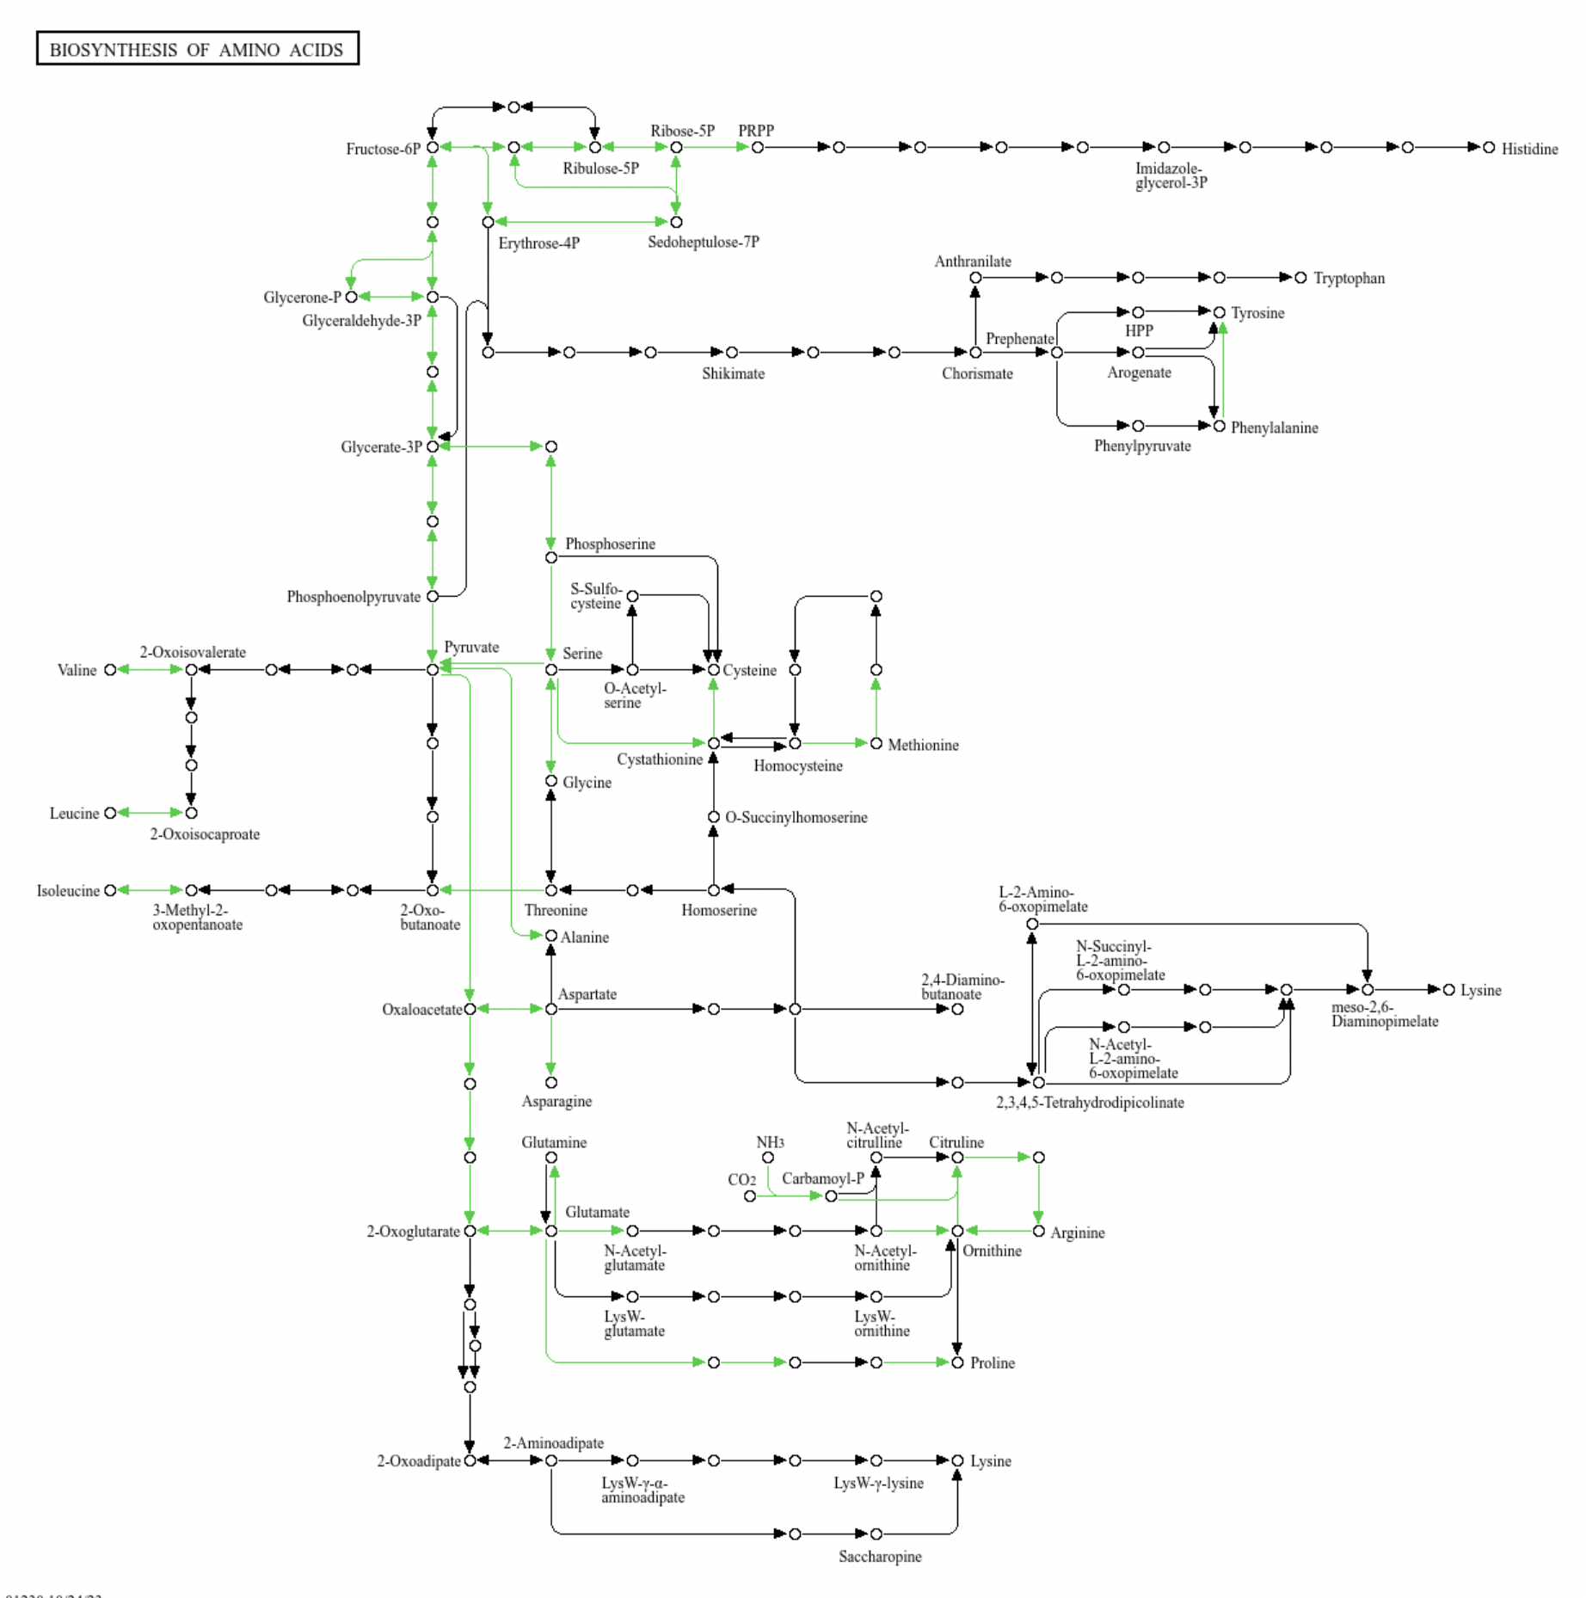
KEGG Pathway for Amino Acid Biosynthesis

Slide 3
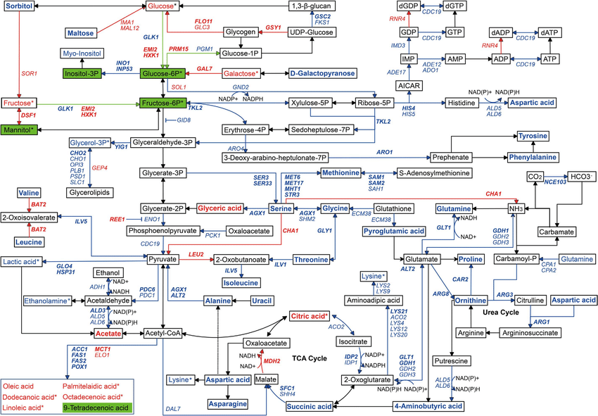
Yeast Central Metabolic Pathways

Slide 4
What’s a Module?
Oxford dictionary: “a set of standardized parts or independent units that can be used to construct a more complex structure, such as an item of furniture or a building.”
Parnas, 1972 “The specification must provide to the intended user all the information that he will need to use the program correctly…”
Defining properties
Modules only interact through well-defined inputs and outputs.
Modules have clearly defined behaviors.
Modules can be composed of other modules.

Slide 5
Why are modules important?
Testing
Testing can be done on modules in isolation (e.g., unit tests)
Analysis
Provides hierarchical decomposition of complex systems
Design
Design is simplified by having modules that perform “big” functions.
Reuse
Modules are sharable and easy to incorporate (although this can be complicated by dependencies).

Slide 6
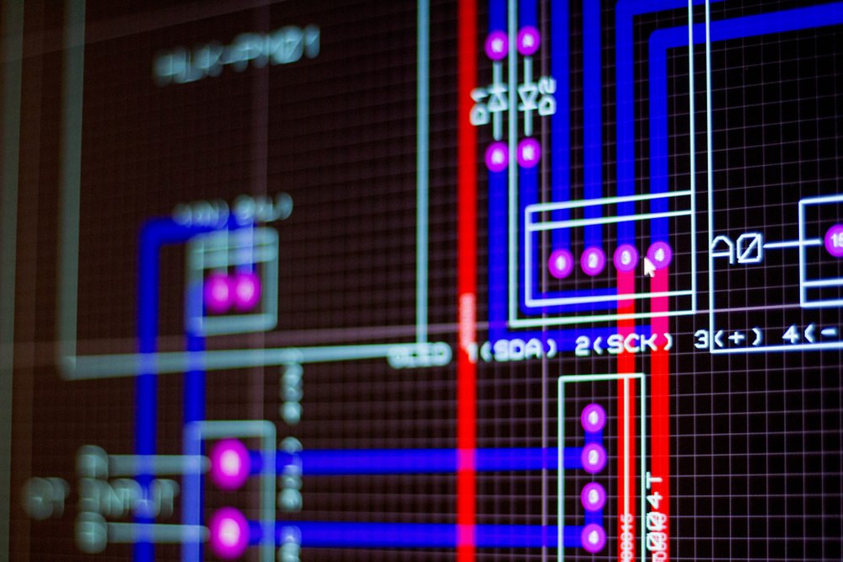
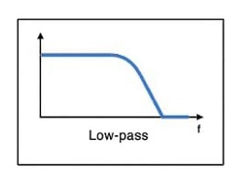
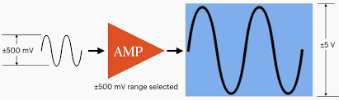
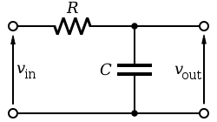
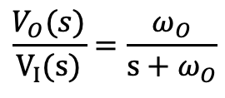
Modules in Electrical Engineering
SPICE Design System
Vision: Design reaction networks based on desired input/output relationships
Inputs & outputs are species concentrations (signals)
Modules (subnetworks) transform signals in known ways
Given a desired output signal, automatically design the reaction network
Amplifier
Low pass filter
$$\frac{V_{O}(s)}{V_{I}(s)}=\frac{ω_{O}}{s+ω_{O}}$$
frequency

Slide 7

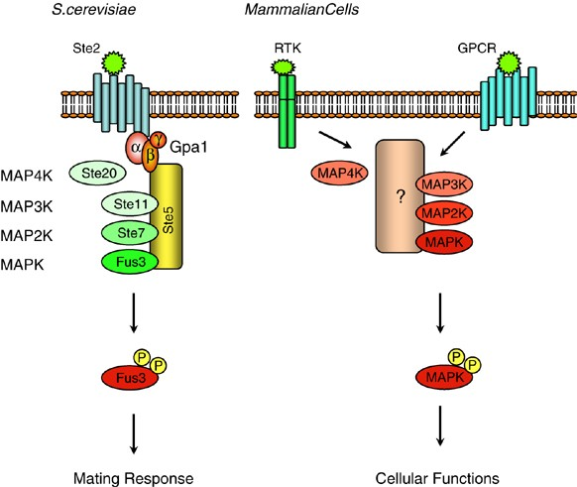
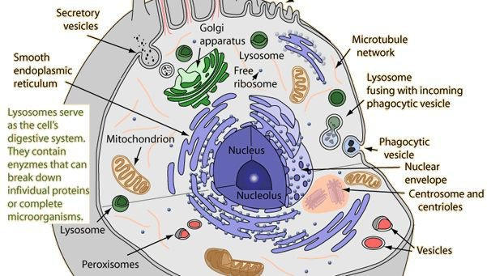
Chemistry Requires Co-location. Co-location complicates modular interactions.
One Pot Reaction
Scaffolds & Complexes
Organelles & Vesicles

Slide 8
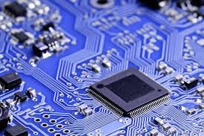
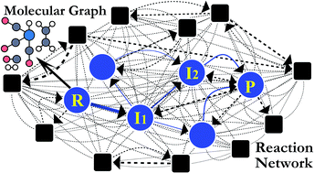
Isolating modules
Electrical packaging & wiring
Molecules With Limited Interactions

Slide 9
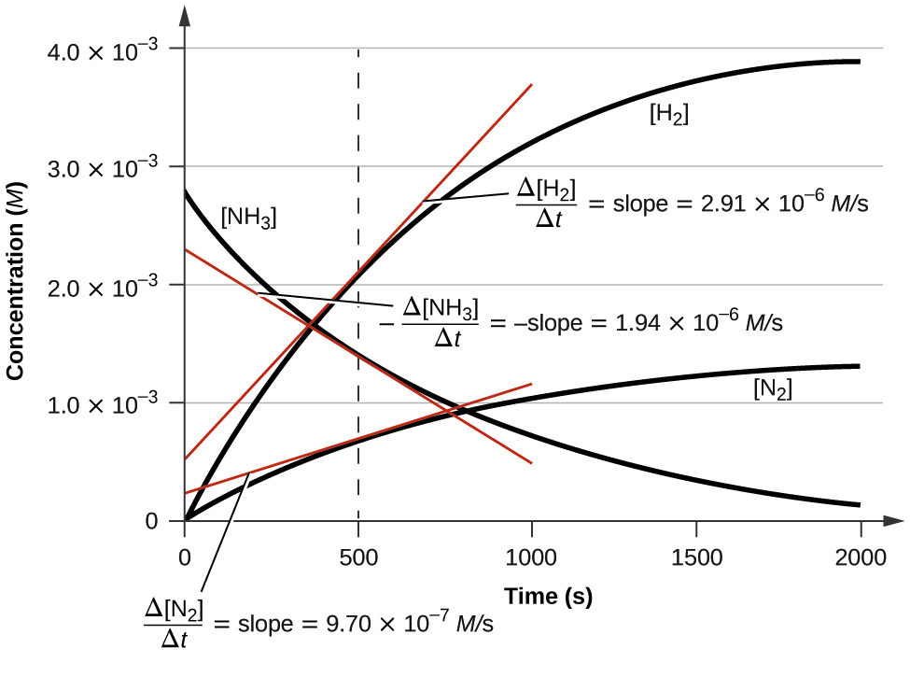
Chemical Modules
Modules have input and output chemical species
Solution: Define appropriately
Modules only interact through their inputs and outputs
Solution: Choose chemical species appropriately
Modules have a well described behavior, the time course of the output concentrations based on the time course of the input concentrations.
Solution: ??

Slide 10
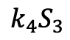
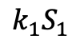
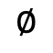
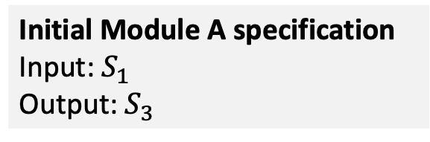
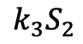
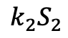
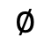
A Simple Module
Module A
Assumptions
Single input single output (SISO)
Can be combined to make multiple input, multiple output
Linear kinetics
Often a reasonable approximation
input
output
S1
$$k_{1}S_{1}$$
S2
$$k_{3}S_{2}$$
S3
$$k_{2}S_{2}$$
$$k_{4}S_{3}$$
$$∅$$
$$∅$$
Reactions
S1 -> S2; k1*S1
S2 -> ; k2*S2
S2 -> S3; k3*S2
S3 -> ; k4*S4
Initial Module A specification
Input: $S_{1}$
Output: $S_{3}$

Slide 11
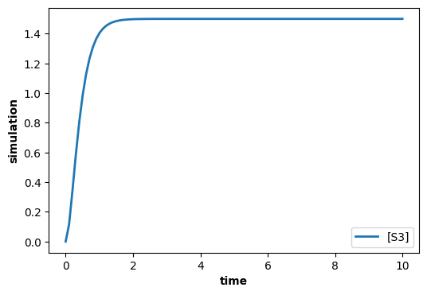
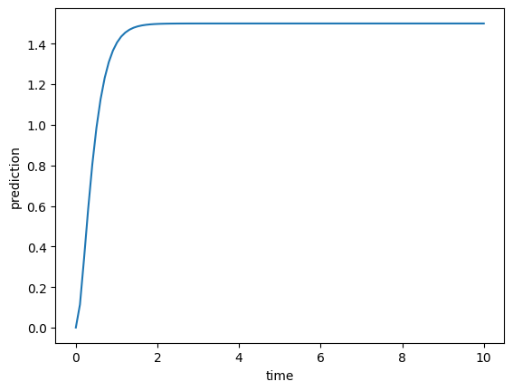
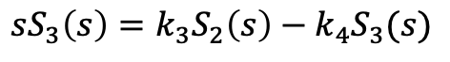
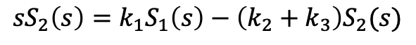
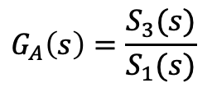
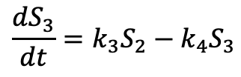
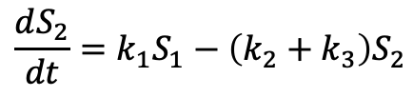
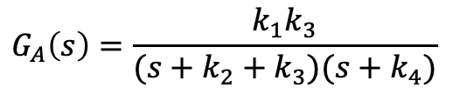
Describing Module Behavior
Module A
Reactions
S1 -> S2; k1*S1
S2 -> ; k2*S2
S2 -> S3; k3*S2
S3 -> ; k4*S4
input
output
S1
$$k_{1}S_{1}$$
S2
$$k_{3}S_{2}$$
S3
$$k_{2}S_{2}$$
$$k_{4}S_{3}$$
$$∅$$
$$∅$$
$$G_{A}\left(s\right)=\frac{S_{3}(s)}{S_{1}(s)}$$
Transfer function
Reaction Network
Transfer Function
System equations
$${sS}_{2}\left(s\right)=k_{1}S_{1}\left(s\right)−\left(k_{2}+k_{3}\right)S_{2}(s)$$
$$\frac{dS_{2}}{dt}=k_{1}S_{1}−\left(k_{2}+k_{3}\right)S_{2}$$
$${sS}_{3}\left(s\right)=k_{3}S_{2}\left(s\right)−k_{4}S_{3}(s)$$
$$\frac{dS_{3}}{dt}=k_{3}S_{2}−k_{4}S_{3}$$
$$G_{A}\left(s\right)=\frac{k_{1}k_{3}}{(s+k_{2}+k_{3})(s+k_{4})}$$
Accurate prediction of time course.

Slide 12
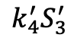
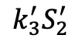
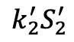
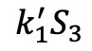
Composing Modules: Concatenation
Module A
Module B
input
output
input
output
S1
$$k_{1}S_{1}$$
S2
$$k_{3}S_{2}$$
S3
S3
$$k_{1}^{′}S_{3}$$
S2’
$$k_{3}^{′}S_{2}^{′}$$
S3’
$$k_{2}S_{2}$$
$$k_{4}S_{3}$$
$$k_{2}^{′}S_{2}^{′}$$
$$k_{4}^{′}S_{3}^{′}$$
$$∅$$
$$∅$$
$$∅$$
$$∅$$
Compose modules by making S3 both the output of A and the input to B.
But behavior changes because the output of Module A is affected by the input of Module B. This is called retroactivity.

Slide 13
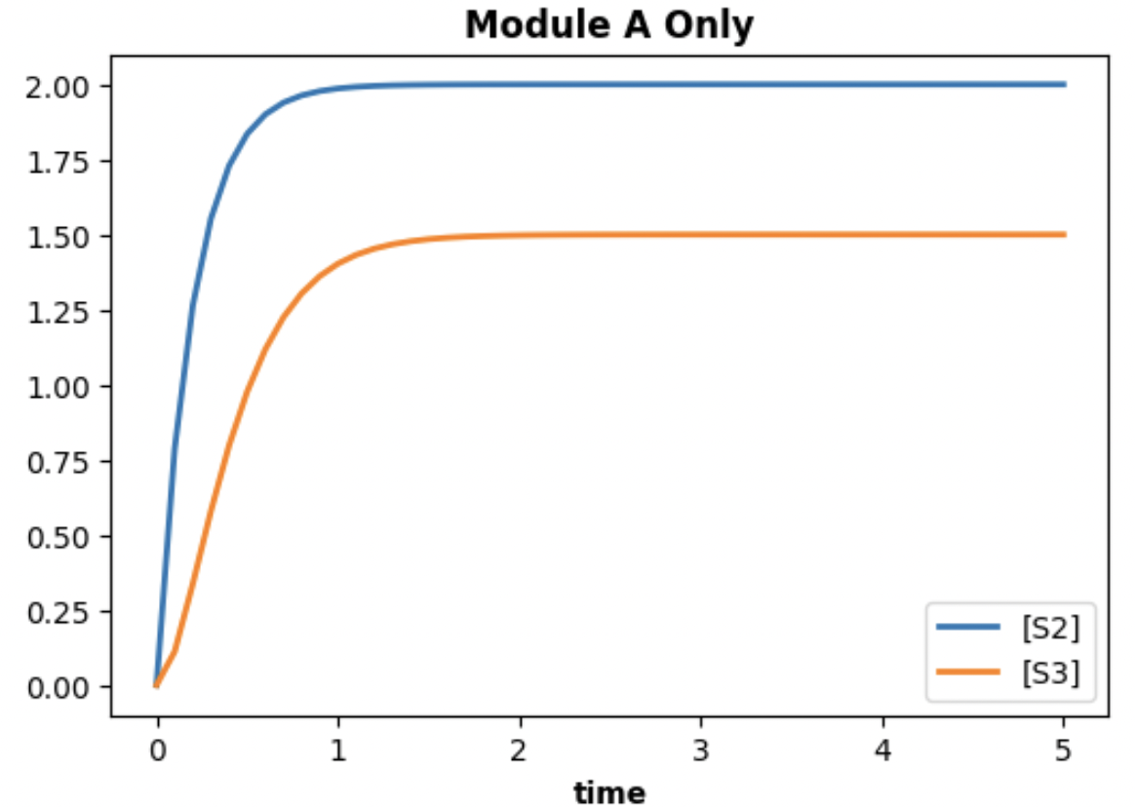
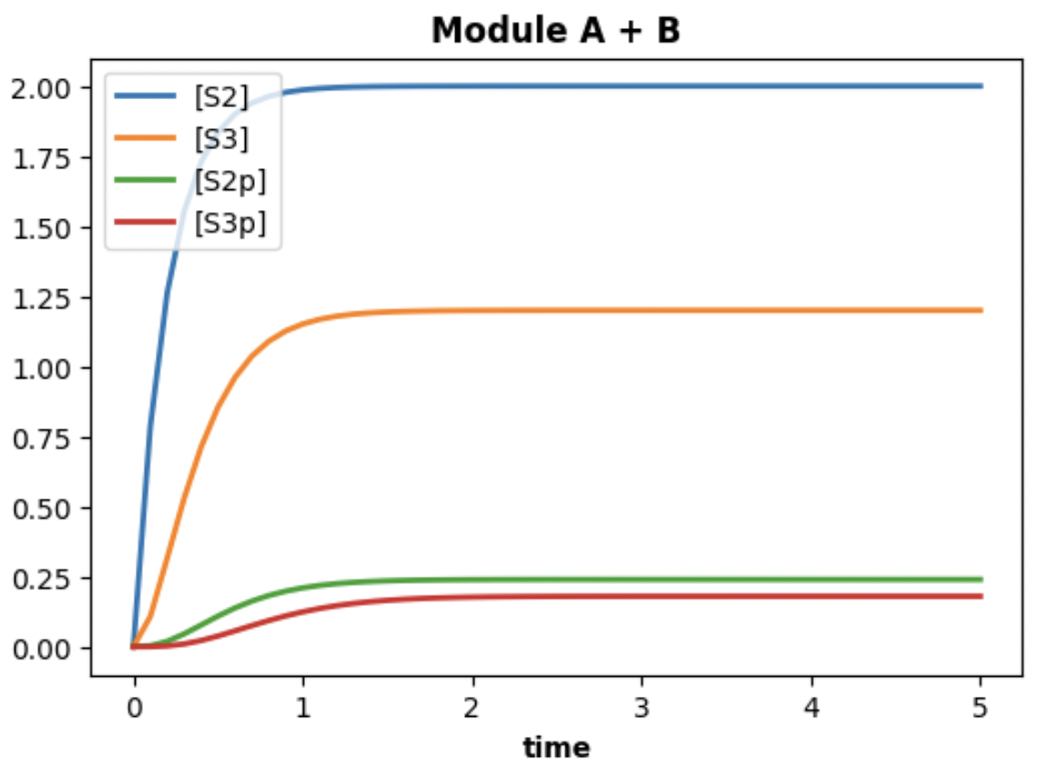
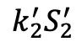
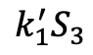
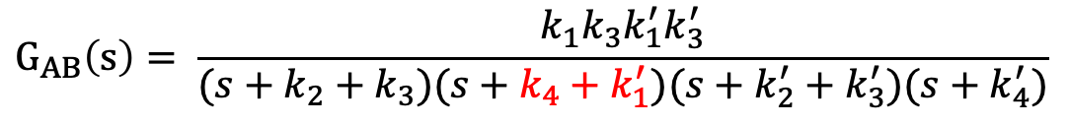

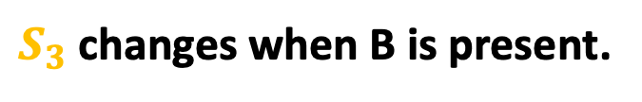
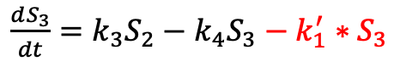
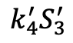
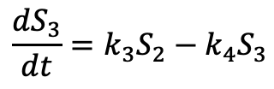
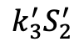
Retroactivity: Module B Affects Module A
Module A
Module B
input
output
input
output
S1
$$k_{1}S_{1}$$
S2
$$k_{3}S_{2}$$
S3
S3
$$k_{1}^{′}S_{3}$$
S2’
$$k_{3}^{′}S_{2}^{′}$$
S3’
$$k_{2}S_{2}$$
$$k_{4}S_{3}$$
$$k_{2}^{′}S_{2}^{′}$$
$$k_{4}^{′}S_{3}^{′}$$
$$∅$$
$$∅$$
$$∅$$
$$∅$$
$S_{3}$ changes when B is present.
Module A in Isolation
Module A with Module B
Transfer function changes
$$G_{A}\left(s\right)= \frac{k_{1}k_{3}}{(s+k_{2}+k_{3})(s+k_{4})}$$
$$\frac{dS_{2}}{dt}=k_{1}S_{1}−\left(k_{2}+k_{3}\right)S_{2}$$
$$\frac{dS_{2}}{dt}=k_{1}S_{1}−\left(k_{2}+k_{3}\right)S_{2}$$
$$\frac{dS_{3}}{dt}=k_{3}S_{2}−k_{4}S_{3}$$
$$G_{AB}\left(s\right)= \frac{k_{1}k_{3}k_{1}^{′}k_{3}^{′}}{(s+k_{2}+k_{3})(s+k_{4}+k_{1}^{′})(s+k_{2}^{′}+k_{3}^{′})(s+k_{4}^{′})}$$
$\frac{dS_{3}}{dt}=k_{3}S_{2}−k_{4}S_{3}−k_{1}^{′}∗S_{3}$
Notes:
Analogous to current in electrical circuits
Can be analyzed mathematically

Slide 14
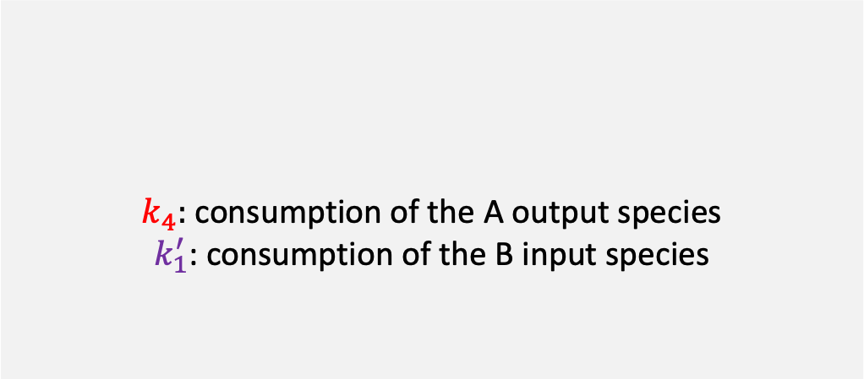
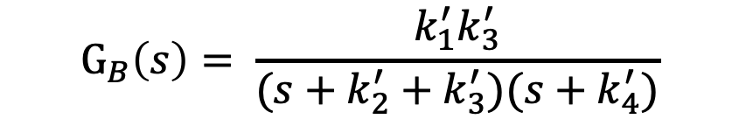
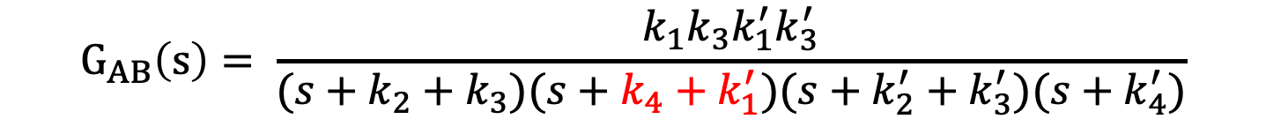
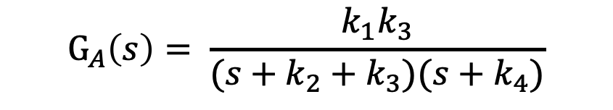
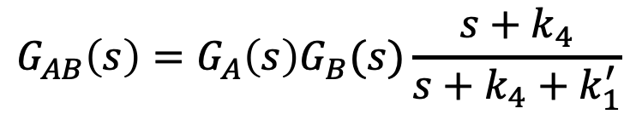
Adjusting for Retroactivity
Module A
Module B
input
output
input
output
S1
$$k_{1}S_{1}$$
S2
$$k_{3}S_{2}$$
S3
S3
$$k_{1}^{′}S_{3}$$
S2’
$$k_{3}^{′}S_{2}^{′}$$
S3’
$$k_{2}S_{2}$$
$$k_{4}S_{3}$$
$$k_{2}^{′}S_{2}^{′}$$
$$k_{4}^{′}S_{3}^{′}$$
$$∅$$
$$∅$$
$$∅$$
$$∅$$
$k_{4}:$ consumption of the A output species
$k_{1}^{′}$: consumption of the B input species
Adjustment
$$G_{A}\left(s\right)= \frac{k_{1}k_{3}}{(s+k_{2}+k_{3})(s+k_{4})}$$
$$G_{AB}\left(s\right)=G_{A}\left(s\right)G_{B}(s)\frac{s+k_{4}}{s+k_{4}+k_{1}^{′}}$$
$$G_{B}\left(s\right)= \frac{k_{1}^{′}k_{3}^{′}}{(s+k_{2}^{′}+k_{3}^{′})(s+k_{4}^{′})}$$
$$G_{AB}\left(s\right)= \frac{k_{1}k_{3}k_{1}^{′}k_{3}^{′}}{(s+k_{2}+k_{3})(s+k_{4}+k_{1}^{′})(s+k_{2}^{′}+k_{3}^{′})(s+k_{4}^{′})}$$
Notes:
Analogous to current in electrical circuits
Can be analyzed mathematically

Slide 15
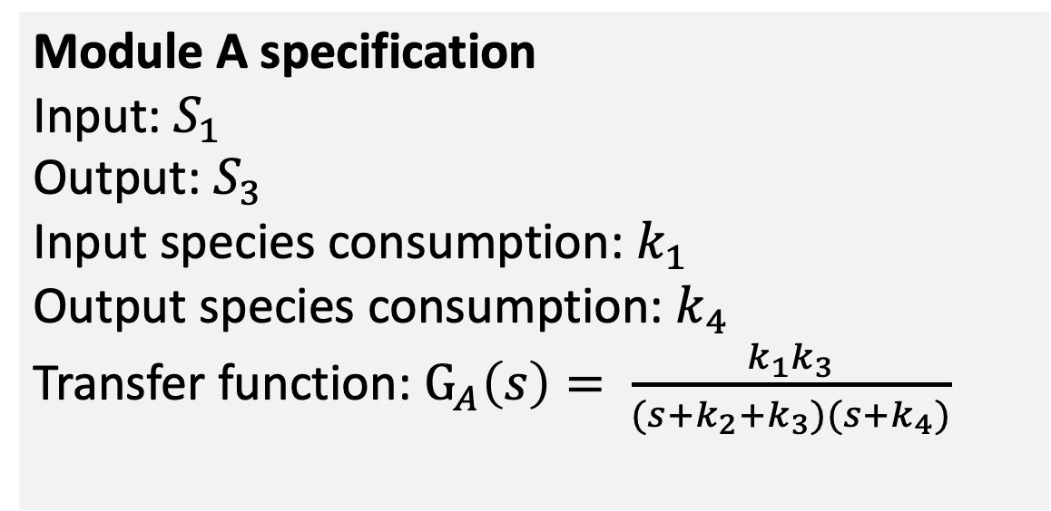
Revised Model Specification
Module A
input
output
S1
$$k_{1}S_{1}$$
S2
$$k_{3}S_{2}$$
S3
$$k_{2}S_{2}$$
$$k_{4}S_{3}$$
$$∅$$
$$∅$$
Module A specification
Input: $S_{1}$
Output: $S_{3}$
Input species consumption: $k_{1}$
Output species consumption: $k_{4}$
Transfer function: $G_{A}\left(s\right)= \frac{k_{1}k_{3}}{(s+k_{2}+k_{3})(s+k_{4})}$

Slide 16
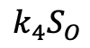





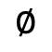



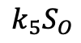




























SISO Operators
branch
$$G^{1}(s)$$
scale
positive feedback
$$S_{I}^{B_{1}}$$
$$S_{O}^{B_{1}}$$
$$GA(s)$$
$$GA(s)$$
$$k_{1}S_{I}$$
$$k_{2}X_{I}$$
$$G(s)$$
$$k_{3}S_{O}^{A}$$
$$S_{I}^{A}$$
$$S_{O}^{A}=$$
$$S_{I}^{A}$$
$$S_{O}^{A}=$$
$$S_{I}$$
$$X_{I}$$
$$S_{I}^{A}$$
$$S_{O}^{A}$$
$$S_{O}$$
$$G^{B_{n}}(s)$$
$$k_{4}S_{O}$$
$$S_{O}^{A}=S_{I}^{B_{i}}$$
$$S_{I}^{B_{n}}$$
$$S_{O}^{B_{n}}$$
$$k_{5}S_{O}$$
$$S_{I}^{B_{n}}$$
$$∅$$
join
negative feedback
$$G^{1}(s)$$
$$S_{I}^{B_{1}}$$
$$S_{O}^{B_{1}}$$
$$k_{I}S_{I}$$
$$k_{1}S_{ff}$$
$$GA(s)$$
$$S_{I}$$
$$S_{ff}$$
$$S_{O}$$
$$S_{I}^{A}$$
$$S_{O}^{A}=$$
$$G_{fb}(s)$$
$$k_{fb}S_{O}$$
$$G^{B_{n}}(s)$$
$$∅$$
$$k_{O}S_{O}$$
$$S_{I}^{B_{n}}$$
$$S_{O}^{B_{n}}$$

Slide 17








Negative Feedback
$$k_{I}x_{I}$$
$$k_{1}x_{FF}$$
$$S_{I}$$
$$S_{FF}$$
$$S_{O}$$
$$k_{FB}x_{O}$$
$$G_{FF}(s)$$
$$∅$$
$$k_{O}x_{O}$$

Slide 18













Modular View of Del Vecchio System
$$M_{1}$$
$$M_{2}$$
$$Z$$
$$k_{Z}Z$$
$$k_{p}X_{P}$$
$$X$$
$$X_{P}$$
$$X_{P}$$
$$p$$
$$T$$
$$k_{Y}X_{P}$$
$$Y$$

Slide 19











Modification of Del Vecchio Insulation Device
$$M_{1}^{′}$$
$$k_{A}Z_{A}$$
$$Z_{A}$$
$$Z_{B}$$
$$k_{B}Z_{B}$$
$$k_{FB}X_{P}$$
$$X$$
$$X_{P}$$
$$∅$$
$$k_{Y}X_{P}$$
$$Y$$

Slide 20


Transfer Functions of Modules Created by Operators
Operation | Transfer Function
scale | $$G^{A}\left(s\right)\frac{s+k_{O}^{A}}{s+k_{O}^{A}+k_{1}^{S}}\frac{m^{′}k_{1}^{S}}{s+k_{2}^{S}}$$
concatenate | $$G^{A}\left(s\right)G^{B}\left(s\right)\frac{s+k_{O}^{A}}{s+k_{I}^{B}+k_{O}^{A}}$$
branchjoin | $$k_{1a}k_{2a}G^{A}\left(s\right)\frac{s+k_{O}^{A}}{α\left(s\right)(s+k_{3})}+k_{1b}k_{2b}G^{B}\left(s\right)\frac{s+k_{O}^{B}}{β(s)(s+k_{3})}$$
negative feedback | $$\frac{−k_{O}}{s+k_{I}}$$
Positive feedback | $$\frac{k_{1}k_{2}k_{3}G′(s)}{\left(s+k_{4}+k_{5}\right)\left(s+k_{2} \right)−k_{2}k_{3}k_{5}G^{′}(s)}$$
The reduction in output for a system whose output is consumed internally with kinetics k_O
Attached to a system whose input is internally consumed with kinetics k_I is:
$$\frac{k_{O}}{k_{O}+k_{I} }$$

Slide 21



Related Work on Biochemical Modules: 1
Alternatives to information hiding.
Standardized biological parts.
Predicting Gene Ontology annotations.
No formalization of the time course behavior of modules as is needed in a design system.

Slide 22



Related Work on Biochemical Modules: 2
Avoids retroactivity by using catalysts as signals.
Compensating for retroactivity.
Calculating fluxes and concentrations as an analog to I-V analysis in EE.
No definition of modules that addresses retroactivity. No concept of operations on modules.

Slide 23
BACKUP

Slide 24







Compensating for retroactivity
Module A
Module B
input
output
input
output
S1
$$k_{1}S_{1}$$
S2
$$k_{3}S_{2}$$
S3
S3
$$k_{1}^{′}S_{3}$$
S2’
$$k_{3}^{′}S_{2}^{′}$$
S3’
$$k_{2}S_{2}$$
$$k_{4}S_{3}$$
$$k_{2}^{′}S_{2}^{′}$$
$$k_{4}^{′}S_{3}^{′}$$
$$∅$$
$$∅$$
$$∅$$
$$∅$$
Module definition includes input consumption rate ($k_{1}$) and output conversation rate ($k_{4}S_{3}$).
Adjust the transfer function.
Module A in Isolation
Module A with Module B
$$\frac{dS_{2}}{dt}=k_{1}S_{1}−\left(k_{2}+k_{3}\right)S_{2}$$
$$\frac{dS_{2}}{dt}=k_{1}S_{1}−\left(k_{2}+k_{3}\right)S_{2}$$
$$\frac{dS_{3}}{dt}=k_{3}S_{2}−k_{4}S_{3}$$
$\frac{dS_{3}}{dt}=k_{3}S_{2}−k_{4}S_{3}−k_{1}^{′}∗S_{3}$

Slide 25





























SISO Operators
concatenate
scale
positive feedback
$$GA(s)$$
$$G^{B}(s)$$
$$GA(s)$$
$${k_{1}S}_{O}^{A}$$
$$k_{1}S_{I}$$
$$k_{2}X_{I}$$
$$G(s)$$
$$k_{3}S_{O}^{A}$$
$$S_{I}^{A}$$
$${=S}_{I}^{B}$$
$$S_{O}^{B}$$
$$S_{I}=$$
$$S_{I}^{A}$$
$$S_{O}^{A}=$$
$${m′S}_{O}$$
$$S_{I}$$
$$X_{I}$$
$$S_{I}^{A}$$
$$S_{O}^{A}$$
$$S_{O}$$
$$S_{O}^{A}=$$
$$k_{2}S_{O}$$
$$k_{4}S_{O}$$
$$∅$$
$$k_{5}S_{O}$$
$$∅$$
branchjoin
negative feedback
$$k_{1a}^{}S_{I}$$
$$GA(s)$$
$$S_{I}^{A}$$
$$S_{O}^{A}$$
$$k_{2a}^{}S_{O}^{A}$$
$$k_{1}S_{I}$$
$$k_{2}X_{I}$$
$$G(s)$$
$$k_{3}S_{O}^{A}$$
$$S_{I}$$
$$X_{I}$$
$$S_{I}^{A}$$
$$S_{O}^{A}$$
$$S_{O}$$
$$S_{I}$$
$$S_{O}$$
$$k_{5}S_{O}$$
$$k_{4}S_{O}$$
$$k_{1b }^{}S_{I}$$
$$G^{B}(s)$$
$$k_{2b}^{}S_{O}^{B}$$
$$k_{3}S_{O}$$
$$S_{I}^{B}$$
$$∅$$
$$∅$$
$$∅$$
$$S_{O}^{B}$$

